Slide 1
Healthfirst Backup and Archiving

Slide 2
Current Backup State

Slide 3
Current Backup Systems
  Different backup applications and hardware
  IBM TSM and IBM 3310
  EMC Isilon (Daily snapshot 30 days)
  IBM TSM and EMC DataDomain
  Dell Lightspeed and EMC DataDomain
  Dell Lightspeed and HPE StoreOnce
  HPE DataProtector and StoreOnce

Slide 4
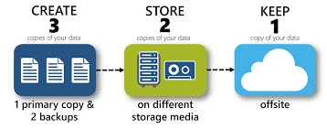
3-2-1 Backup Rule
Need to keep three copies of data
Keep at least three copies of data – Original + two backups
Keep the two backups on two different media types
Store one Backup off site

Slide 5
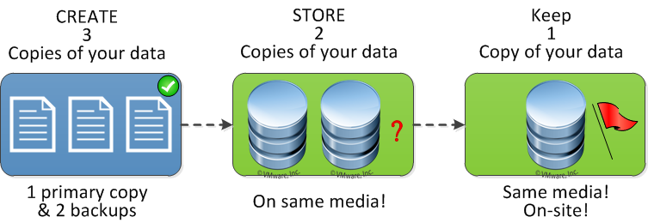
3-2-1 Backup Rule
HF Does not adhere to 3-2-1 Backup Rule
For StoreOnce Backup?
Primary copy on HPE 3PAR StoreServ
Two backup copies on same media, StoreOnce D2D VTL – One @NJ-CL, other @GW-FL
StoreOnce copy at GW-FL is a remote on-site copy on same media: D2D VTL

Slide 6
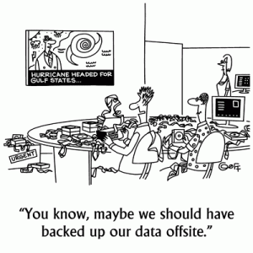
3-2-1 Backup Rule
No Off-site Backup!!!

Slide 7
Current Backup Systems
Backup Type | Backup Application | Backup H/W | Retention | Media | Off Site Method Tape To Iron Mountain? | Notes
Windows shares | TSM | IBM 3310 | 13 months | Tape | Iron Mountain | 70 TB CIFS Isilon goes to Tape backup runs for 25 days 60-70 tapes
Windows shares | Isilon | Isilon | 30 Days | D2D | No | 70 TB CIFS Isilon Daily Snapshot whole Vol Kept for 30 Days
Win Prod servers | TSM | Data Domain | 45 Days | VTL-D2D | No | Win flat files prod servers D2D
MS SQL | TSM | Data Domain | 14 days | VTL-D2D | No | All SQL Backups will be consolidated to StoreOnce D2D
MS SQL | LiteSpeed | StoreOnce | 1 Week | VTL-D2D | None | This backup is managed by DBA Team All SQL Backups will be consolidated to StoreOnce Target NAS-CIFS Share
Exchange | DataProtector | StoreOnce | 14 Days | VTL-D2D | No
Finance Legal Hold SAS files | TSM | Data Domain | 1st Q - 1 Year Retention 2nd Q - 1 Year Retention 3rd Q - 1 Year Retention 4th Q - 10 Year Retention | VTL-D2D | No | Finance Legal Hold SAS data Flat file created by SAS Finance ticketed request Manual Run per ticket Same set of folders are backed up SAS files are restored as per Finance request Each Job will be a full Backup ~ 500 GB
Netezza DW RHEL 5.10 | Netezza Native Backup | Data Domain | 3 Months | D2D | No | Has A DR server in GW QA/Dev is leveraged for DR Backed up to NFS Share
IVR Application Data | TSM | Data Domain | 30 days (Daily Inc.) 13 Months (Monthly Full) | VTL-D2D | No
IVR SQL DB | Lightspeed | StoreOnce | 14 days | NAS-CIFS | No | Backup target is NAS CIFS share on HP StoreOnce CIFS share replicated?

Slide 8
Archiving State
At this time only Finance related data on SAS server is preserved for Legal Hold
Financial SAS Data Retention Policy
  1st Q - 1 Year Retention
  2nd Q - 1 Year Retention
  3rd Q - 1 Year Retention
  4th Q - 10 Year Retention
Archives created per request from Finance

Slide 9
Future Backup Systems and Archiving

Slide 10
Future Backup Systems
All backups systems are currently being consolidated to HPE Data Protector and StoreOnce solution
HP StoreOnce Recovery Manager Central Software also in the mix

Slide 11
3-2-1 Backup Rule
Need to keep three copies of data
Keep at least three copies of data – Original + two backups
Keep the two backups on two different media types
Store one Backup off site

Slide 12
Archiving and Storage Optimization
Archival Requirements
It is important that there is an agreed upon definition about what is archive and what is backup.

Slide 13


Archiving and Storage Optimization
Backup
  Any data that needs to be recovered for DR, data corruption or accidental deletion etc.

Slide 14

Archiving and Storage Optimization
Archive
Archive is driven by legal, compliance, regulatory requirements etc.

Slide 15
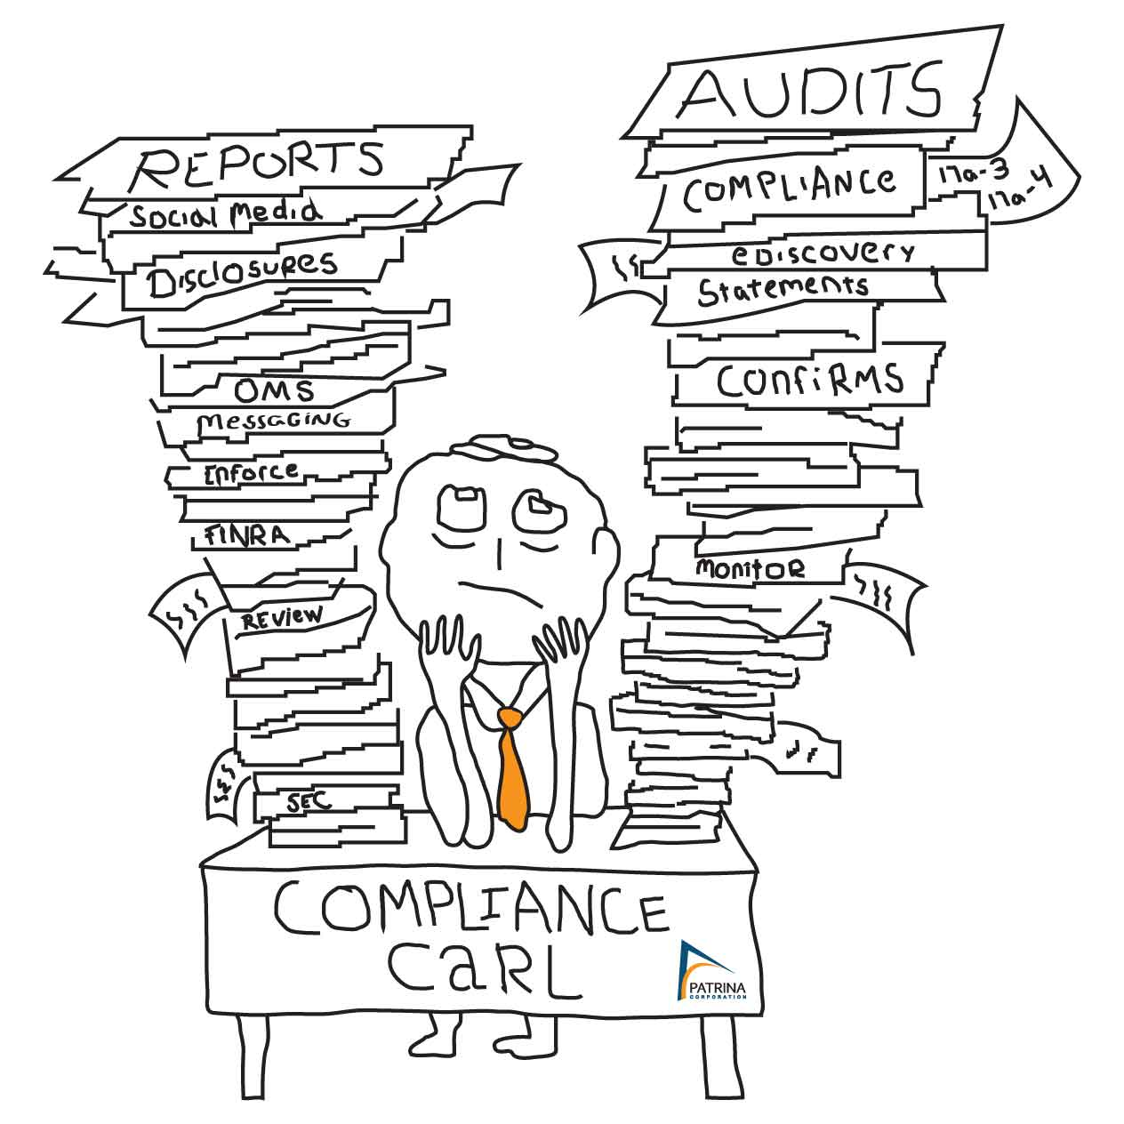
Archiving and Storage Optimization
Compliance …….

Slide 16
Archiving
Two Archiving variations are proposed:
Archiving for legal, compliance and regulatory requirements etc
Archiving for Storage Optimization

Slide 17
Archiving
Archiving for legal, compliance and regulatory requirements
  This data is characterized by these attributes
  (SNIA DMF Building a Terminology Guide May 2009)
  Preservation
    Readability
    Accessibility
    Usability
    Security
    Deal with hardware and software obsolescence
  Discovery
    Able to search required data
    e.g. All files containing patient Jon Doe or all emails with a particular subject
  Protection
    From destruction and deletion

Slide 18
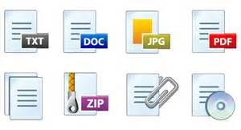
Archiving
Archiving for Storage Optimization
Data is growing at 50% per year (SNIA DMF Building a Terminology Guide May 2009)
Biggest challenge is the growth of unstructured data.
  Unstructured data includes fixed data in electronic format:
  Brochures and Guides
  Emails
  Contracts
  Financial Reports

Slide 19
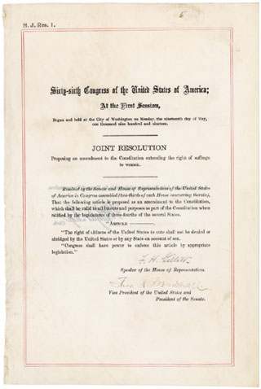
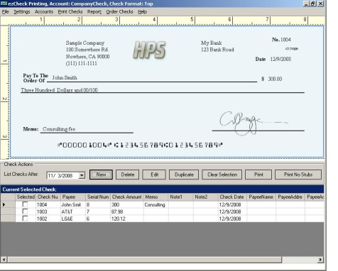
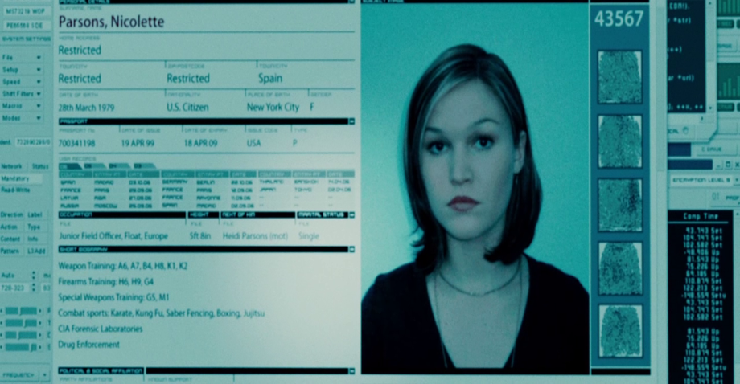
Unstructured Data
Digital Records:
Scanned documents
Checks
Photos
Survey

Slide 20


Unstructured Data
Rich Media:
X-Rays, MRI’s etc
Video
Audio
Voice Mail

Slide 21
Archive Non-Active Data
Most of this data rarely changes once created. This data could be moved to a tiered storage and archived for a period of time and then disposed per HF Records Management policy.

Slide 22
Archive Non-Active Data
Benefits of Archiving for Storage Optimization:
Backup performance!
Manageable backup windows!
Control storage growth on primary expensive storage!

Slide 23

Archive Non-Active Data
Use Case for Storage Optimization:
70 TB CIFS data on Isilon goes to tape for monthly full backup
Backup runs for about 25 days
60 - 70 tapes
One Way of Doing It!!

Slide 24
Archive Non-Active Data
Irrespective of target backup media; tape or
VTL, backup size could be reduced
considerably because inactive data will be
continuously moved off of primary storage
and archived even with net new data
ingestion.

Slide 25
Archive Non-Active Data
Benefits of Archiving for Storage Optimization:
Backup performance!
Manageable backup windows!
Control storage growth on primary expensive storage!

Slide 26

Archive Non-Active Data
= Happy Backup
Admin and End Users

Slide 27
Database Archiving
Extract data from all related tables and archived
How, what, how long needs to be determined

Slide 28
What Next…
Self-contained Information Retention Format (SIRF):
SIRF is a logical container format for the long-term storage of digital information

Slide 29
What Next…
SIRF
It is a logical data format of a mountable unit e.g. a filesystem, a block device, a stream device, an object store, a tape, etc.

Slide 30

What Next…
SIRF
Metaphorically it is a closed bottle that includes all the information needed to understand the bottle's contents at a future point in time.

Slide 31
What Next…
SIRF
A Standard for vendor-neutral storage containers that can be interpreted over time.
Any SIRF compliant application can read and interpret the preservation objects

Slide 32
What Next…
See more at:
  http://www.snia.org/SIRF#sthash.CigU9xEm.dpuf
The SIRF serialization for the cloud is being experimented with OpenStack Swift object
storage, and the implementation is offered as open source in the OpenSIRF

